Slide 1

Notes:
“We thank you for visiting us and welcome you as distinguished guests to the HIRL Lab. I’m Alfred and joining me are Munirah and Meixia.”

Slide 2
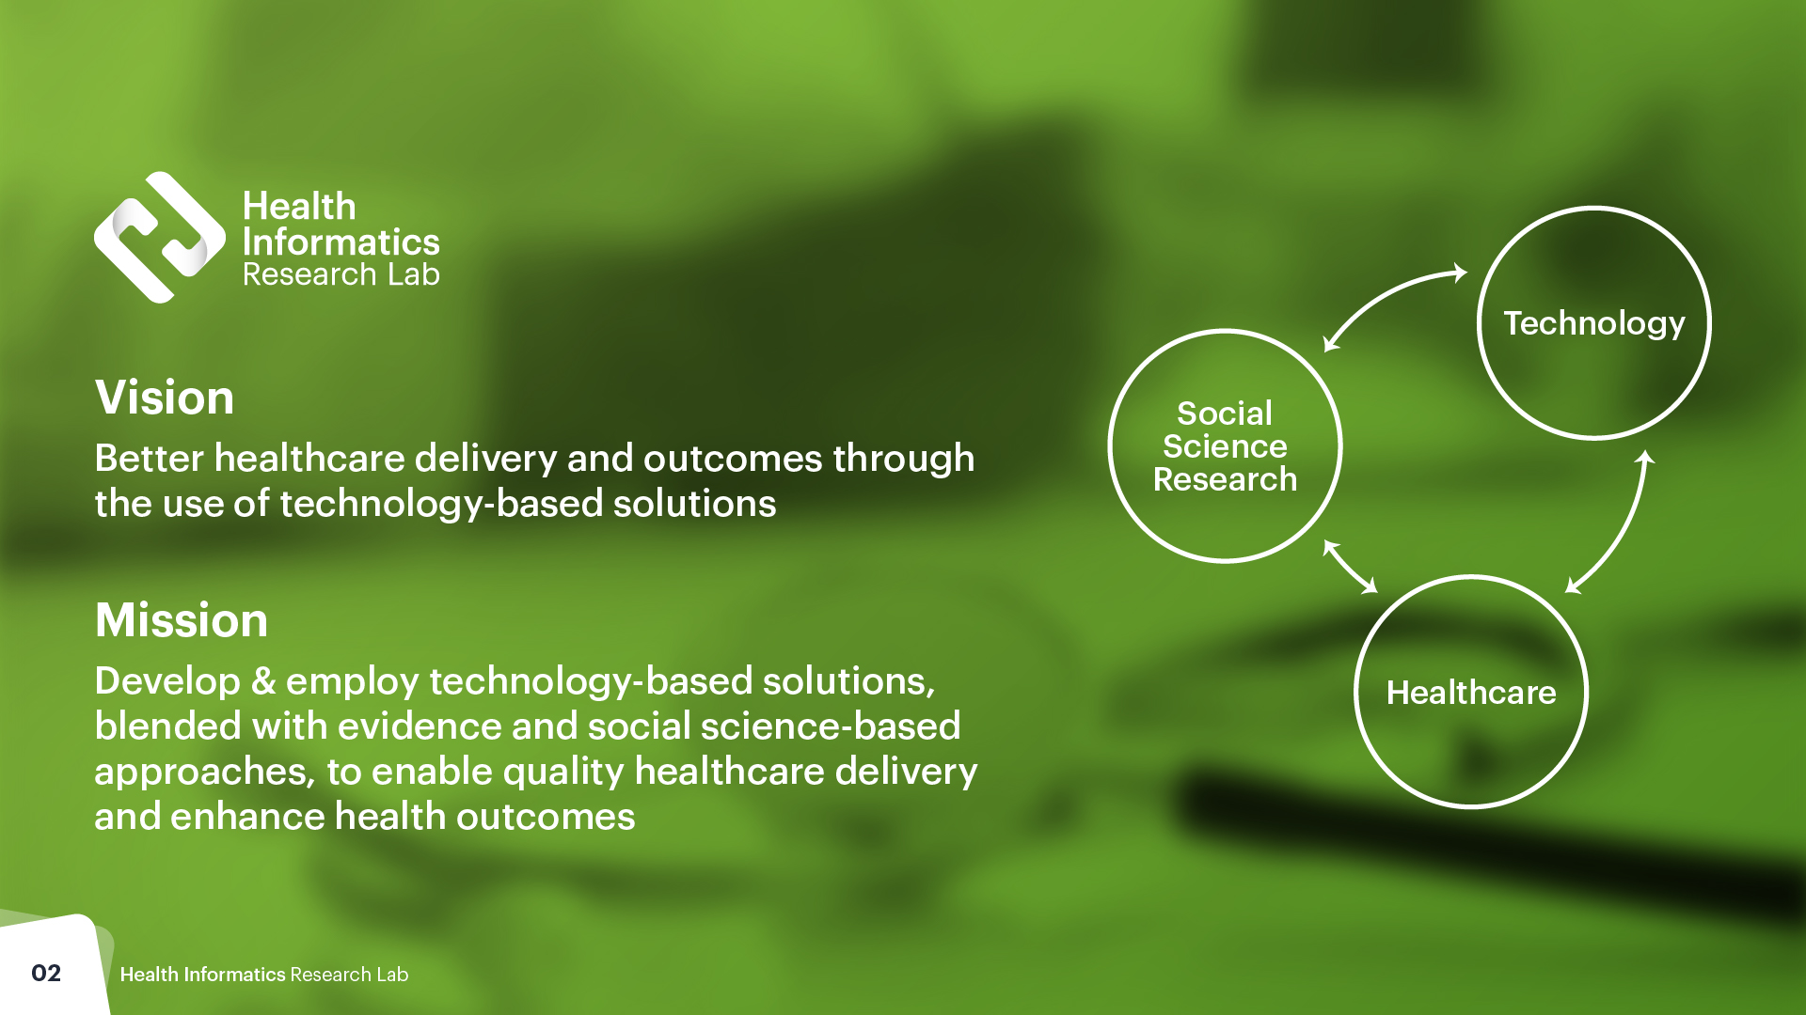
Notes:
“At HIRL, our team strives towards better healthcare delivery and outcomes through the use of technology-based solutions. We realize this vision by developing & employing solutions with IOT devices and platforms, blended with empirical evidence from the ground and contemporary social science-based approaches, to enable quality healthcare delivery and enhance health outcomes.”
“Our solutions contribute enriching applications to preventive healthcare, chronic disease management, and health informatics. Such is done via the combination of three knowledge bases: Healthcare, Social Science, and Technology.“

Slide 3
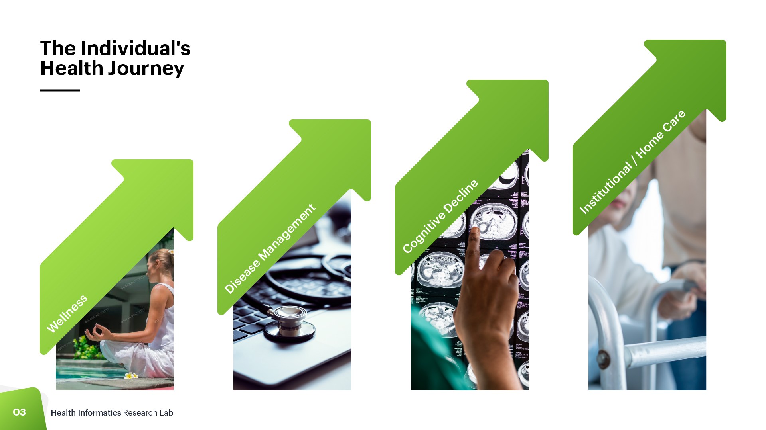
Notes:
“Our current initiatives in HIRL embody the individual’s health journey. We start with wellness before moving on the management of diseases. We then introduce our solution for managing cognitive decline before concluding with our offerings for institutional and home care.”

Slide 4
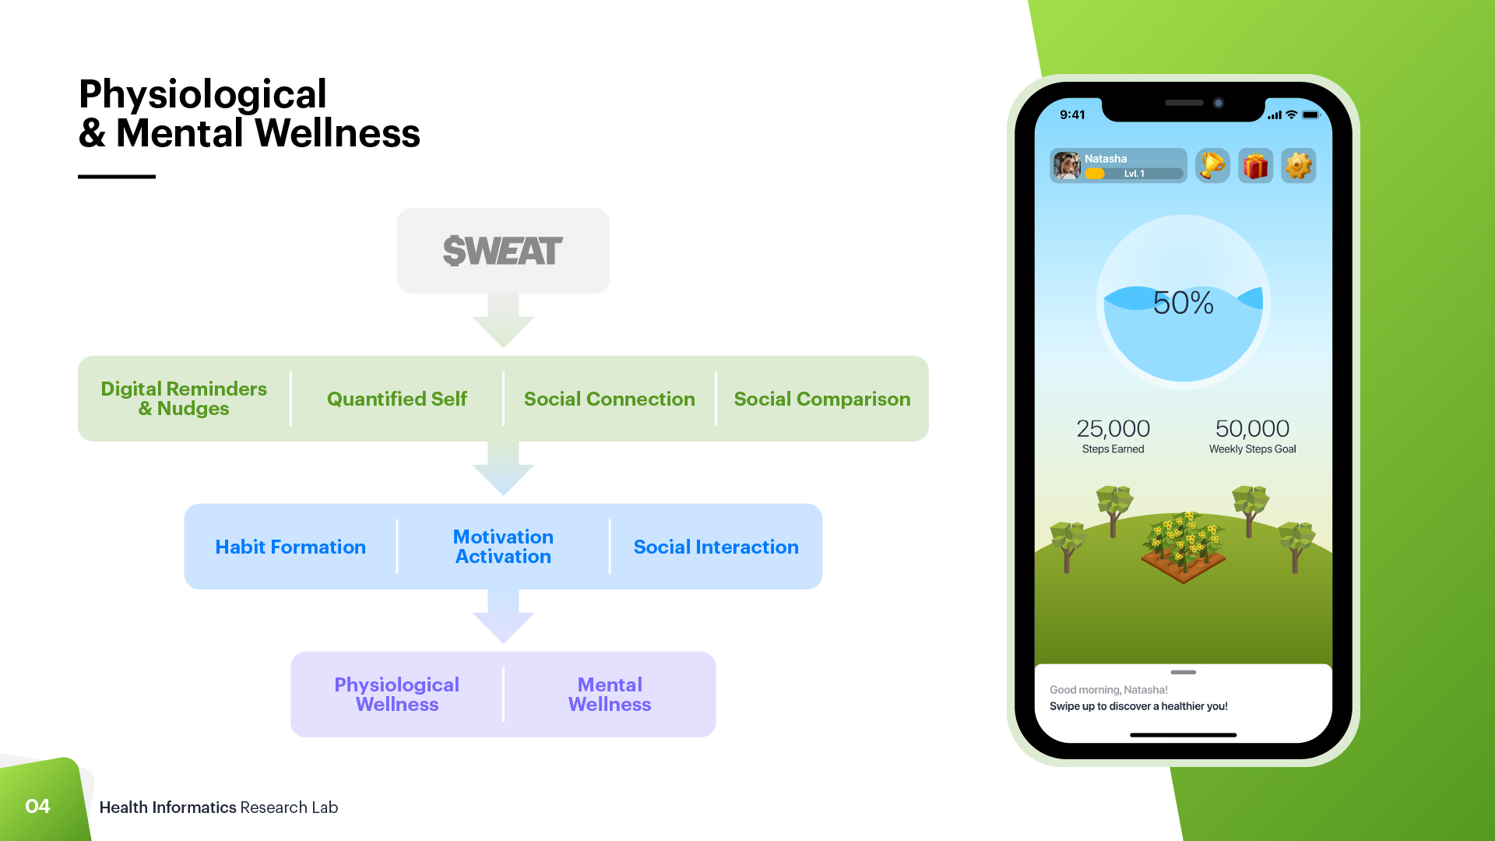
Notes:
“Our first initiative promotes physical and mental wellness. Promoting these wellness addresses both the reduction of disorder and disease while enhancing mental and physical health. Linking these two can help in promoting awareness and informed preventive health.
$WEAT is our solution to directly address this opportunity. It cultivates physiological and mental wellness from habit formation, motivation activation, and social interaction. It combines a mobile app with wearables to provide an interactive, gamified and tailored experience using digital reminders and nudges, quantified self, and social interactions cum comparisons. Prior studies using a prototypical version of $Weat, including a thesis trial, showed that use of the solution was associated with higher likelihood of more motivated physical activity over time if the user was initially found to have low motivation.
$WEAT is currently in development and can be configured for individual clients. It is due to launch in phases in 2023.”
- Line out the current landscape of situation, i.e. have a story board to describe the situation- Provides figures and research facts, how much funding (%) that companies typically spend on health/mental wellness. Increase of suicide rates etc.- Our app is to encourage employees wellness in two aspect: physical and mental

Slide 5
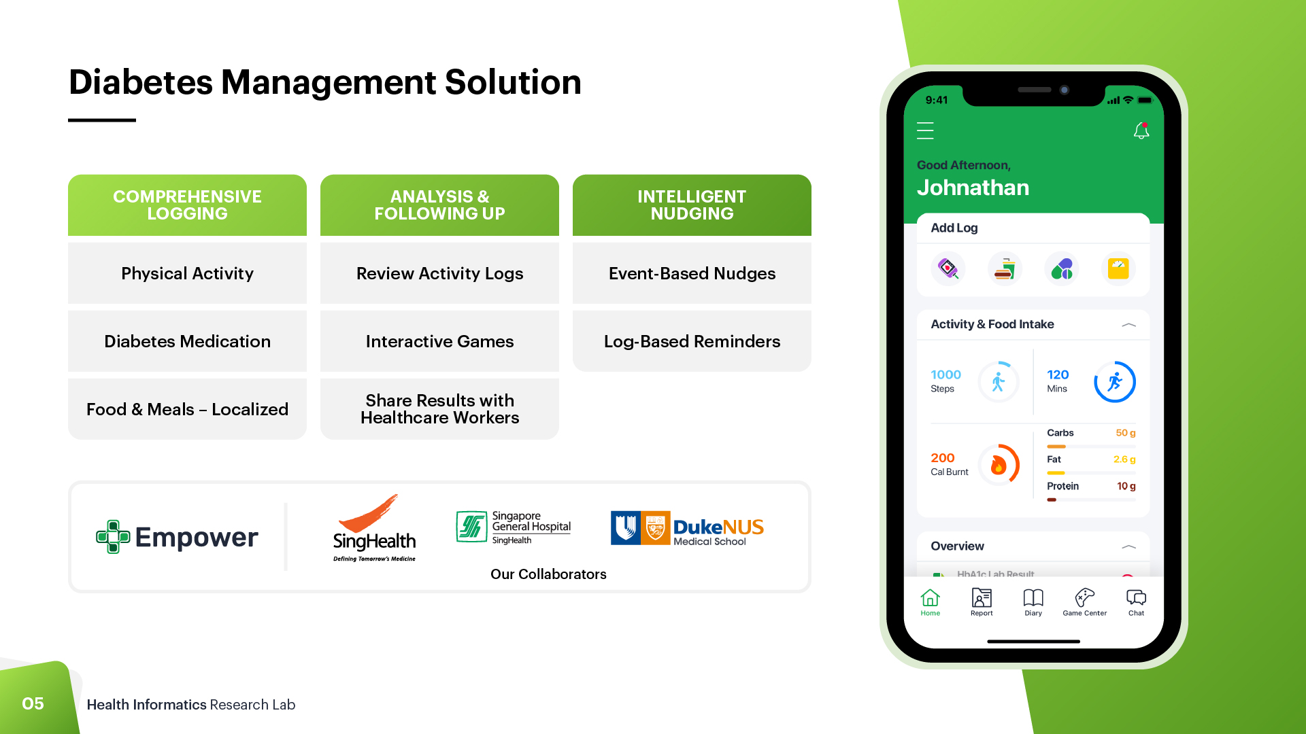
Notes:
“Our next initiative extends the same principles from Wellness to Disease Management, focusing on the management of chronic diseases, specifically Type 2 Diabetes.
1 in 3 deaths in Singapore is due to chronic diseases such as Type 2 Diabetes. This figure is likely to rise as Singapore’s population rapidly ages and the prevalence of these diseases is likely to increase. Together with increasing demands for healthcare workers, there is a pressing need to tap on technology and automation to improve care delivery for elderly patients with Diabetes.
To address this need, we co-partnered with SGH to develop Empower.
Informed by nudging literature and rapid prototyping feedback from ground truths, the Empower platform manages various aspects of diabetes management from medicine logging to exercising to eating healthily, using an intelligent nudging framework.
Patients log their activities and receive intelligent nudges based on these activities with a dedicated mobile app.
They can also follow up on their logs by reviewing them as reports, playing games based on their log activities or sharing their information with HCWs using generated reports.
Coordinators manage data from the patients in an admin portal that administers the nudges and links to the mobile app.
The mobile app, currently available for IOS and Android, introduces modular features including activity logging, journals and a Bingo game with rewards.”

Slide 6
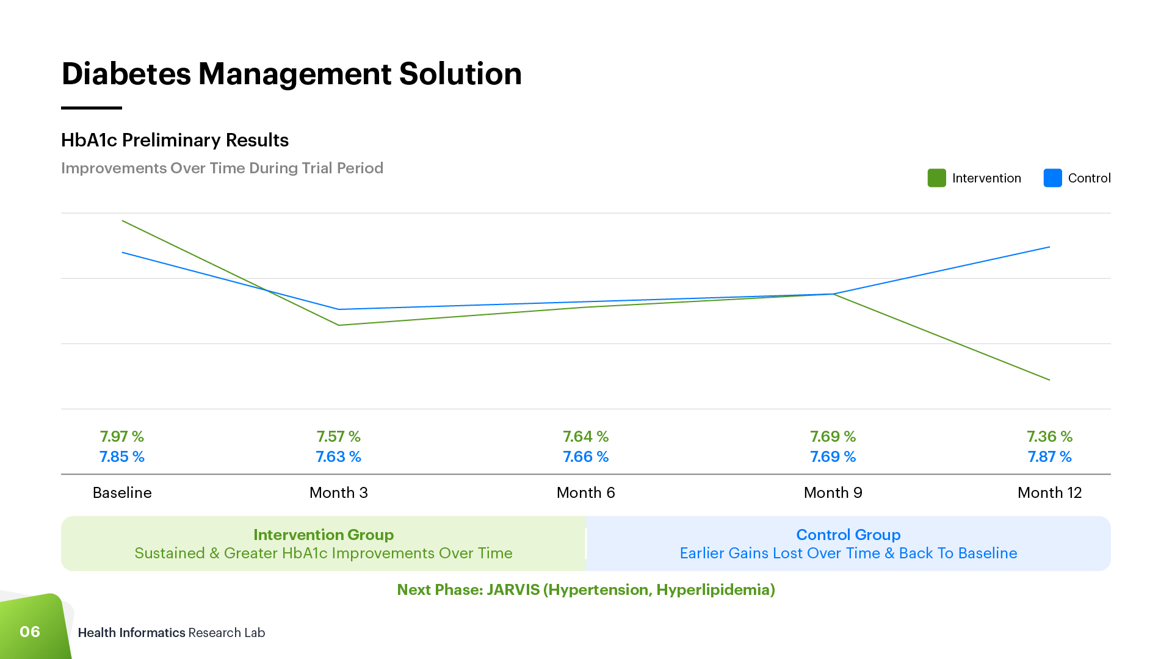
Notes:
“To test its efficacy, Empower is deployed in an ongoing longitudinal field study involving about 1000 elderly patients with diabetes. Recruited from 3 local polyclinics, the participants use the mobile app and tracker for 12 months each. Preliminary results collected in April 2022 from 400 participants reveals that participants in the treatment fared better in diabetes control than those from control. For instance, those who used Empower log their step count more regularly with their trackers than those who don’t, especially after the initial set of nudges introduced in August 2021.
For future work, Empower will be extended to patients with hypertension and hyperlipidemia. Named JARVIS, this new build will introduce features such as synchronous chat with health coaches and blood pressure logging. It is currently in development and will launch in phases between late 2022 and early 2023.”
A little bit of findings
- [Q: What is the IOT part] Based on multiple activity trackers, and continuous glucose machines and blood pressure monitors

Slide 7
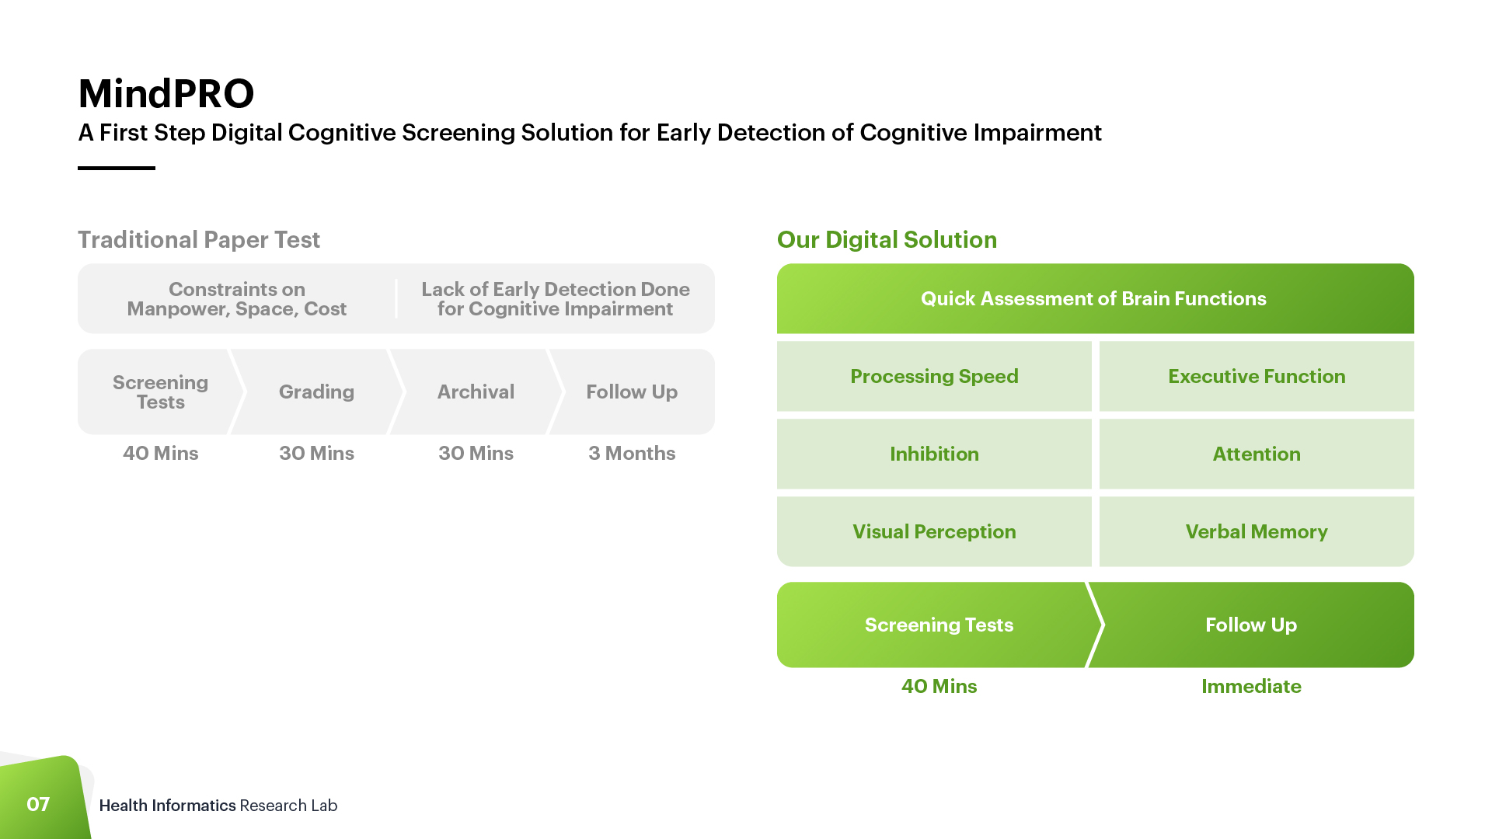
Notes:
Once the individual has reached a stage of cognitive decline, then it would important for them to assess their cognitive function so it does not deteriorate further. Deteriorating further could mean higher costs for their care journey as MRI is costly and neuro psychological screening is at least $400 each time. Due to the high costs of testing, cognitive screening is usually not a first step of action and is only done on a needs basis should a patient complain of memory loss. Hence, we can screen them when they are at the early stages of cognitive impairment before the reach the stage of dementia. This could save hospitals a lot of costs since now they are heavily constrained by space and manpower
The brain is an important function in your life. If you lose control of certain functions in the brain, your life would drastically change, What you see hear are the functions in the different parts of the brain and you can see that the frontal lobe consists of the most amount of functions. As you can imagine, particularly for vascular dementia, those with chronic illnesses and cognitive impairment, the frontal lobe is most affected. Hence it is important to screen for these areas. Our solution is to address the functions affected, particularly the frontal lobe, by coming up with a digital screening app that can test if these functions are affected even at the slightest range so that they can receive help quickly.
Currently, we are developing a Super App prototype to address all the functions more commonly associated with head injuries, dementia and chronic diseases. Since frontal lobe is most affected, most of our tests are made to test for the severity of function.
Out of all the digital tests that we have developed, the digital processing speed test is undergoing a validation in a hospital testing and we are currently testing it with both dementia and healthy participants. We have recruited roughly 320 participants and cos it only takes 5 mins to do, there are instructions and it is auto graded, feedback has been promising from both patients and doctors. Ill show you on the next slide what the app looks like

Slide 8
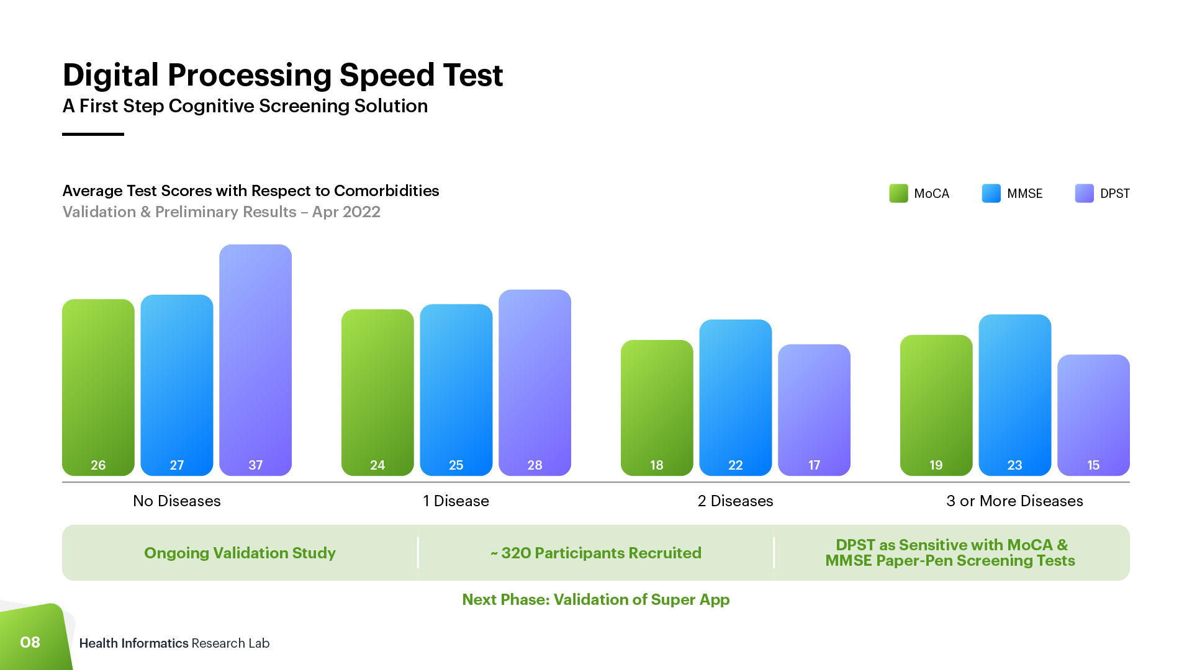
Notes:
This is a sample of what we have shown hospital to depict the correlation of the 2 tests used in hospital versus ours and our test so far has a high correlation.
Side info:
Findings: What this basically means is that on a paper pen screening tests (MoCA and MMSE) that is usually done in hospitals in Singapore, a person would be considered healthy/no cognitive impairment if they scored more than 26 points out of 30 (if they had less than 10 years of education) and more than 27(if they had 10 years of education), and this would correlate with 33 points out of 114 on our DPST. If they had dementia, you would score between 6-23 on our DSPT as the task is harder for a dementia patient.
Conclusion: Good comparability and there is a high potential for use in hospital waiting areas. Hospitals have shown interest in the app being used in their clinics.
Side note for me:
This is to illustrate the correlation between the average scores a patient might get for the 3 tests ( MoCA, MMSE and DPST) with respect to the number of diseases they had. So essentially, someone with no diseases would generally score highly for all 3 tests, and this scores does decrease with the number of comorbidities, since neurological responses are affected by blood flow to the brain, and diseases such as diabetes, cholesterol and hypertension would vastly reduce blood flow.

Slide 9
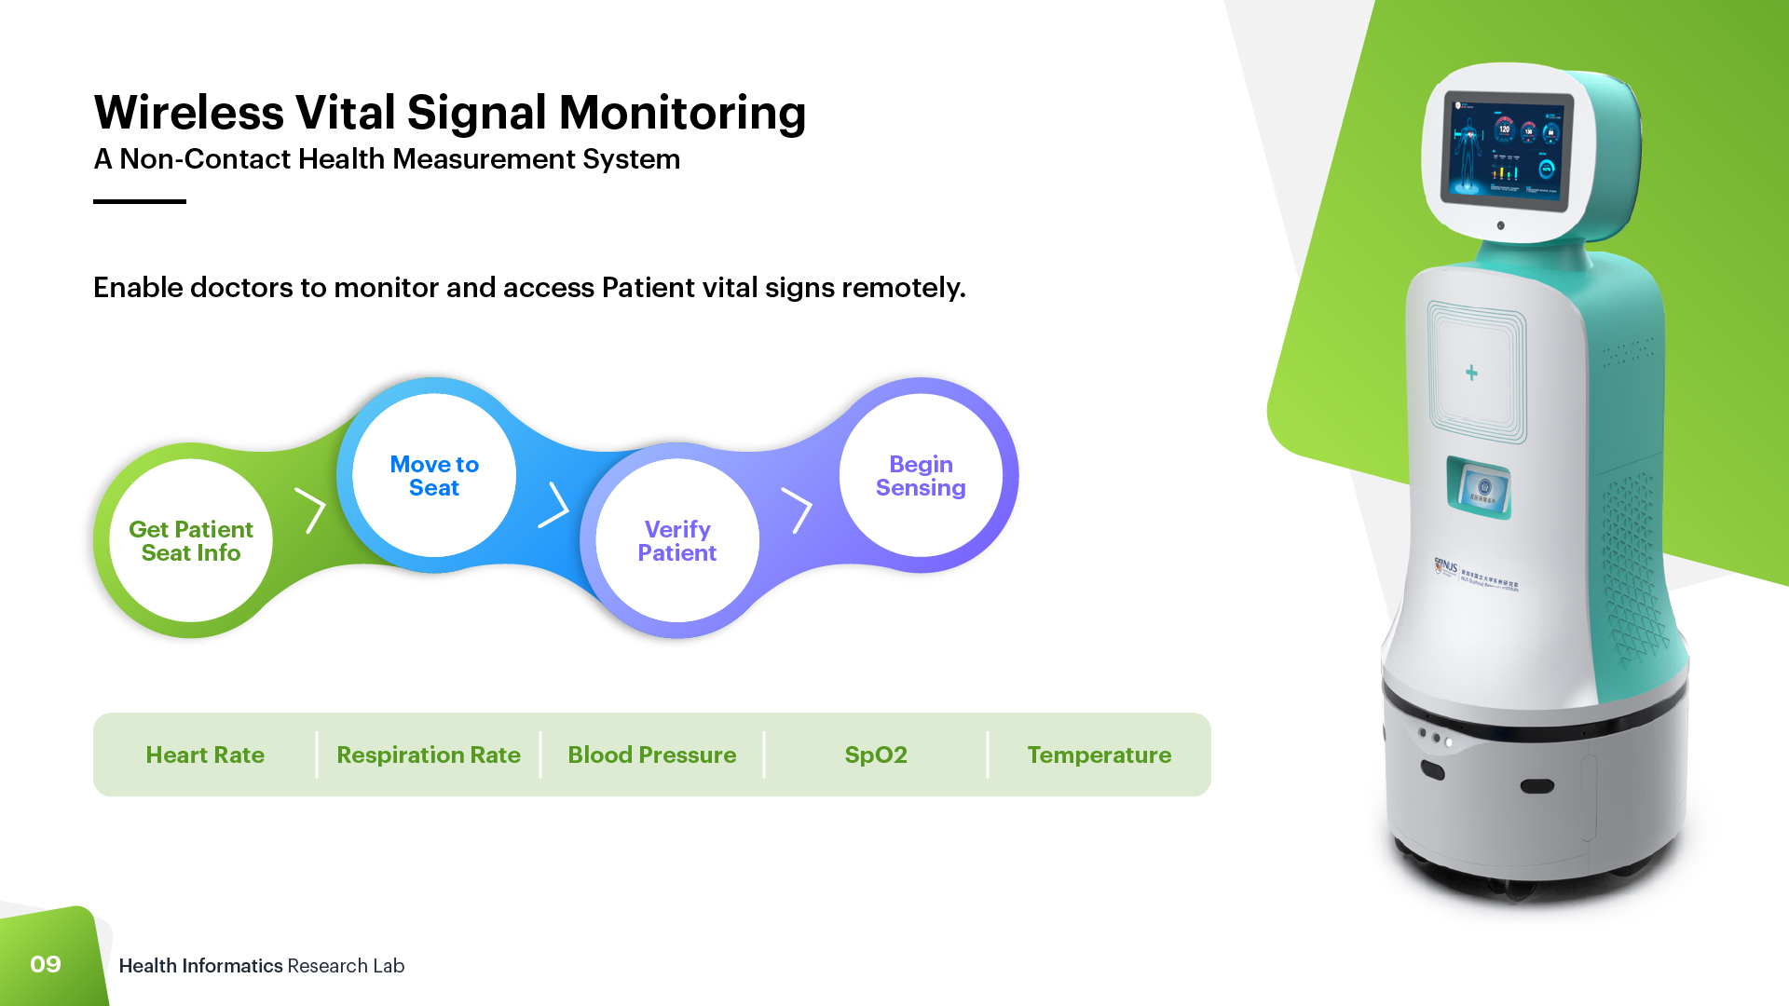
Notes:
Introduction
Problems
Conventional contact sensor-based health measurement systems cause discomfort and inconvenience during the measurement
Some conventional solutions do not support long-term monitoring
Non-contact solutions are desired against the background of COVID-19 situation
Our Solution
An AI-assisted non-contact health measurement system with fusion from a series of non-contact sensors
Eventually, elderly will experience difficulties accessing health care due to immobility. An easy way has to be found to allow doctors to monitor and access their health remotely, and vital signs are one important aspect.

Slide 10
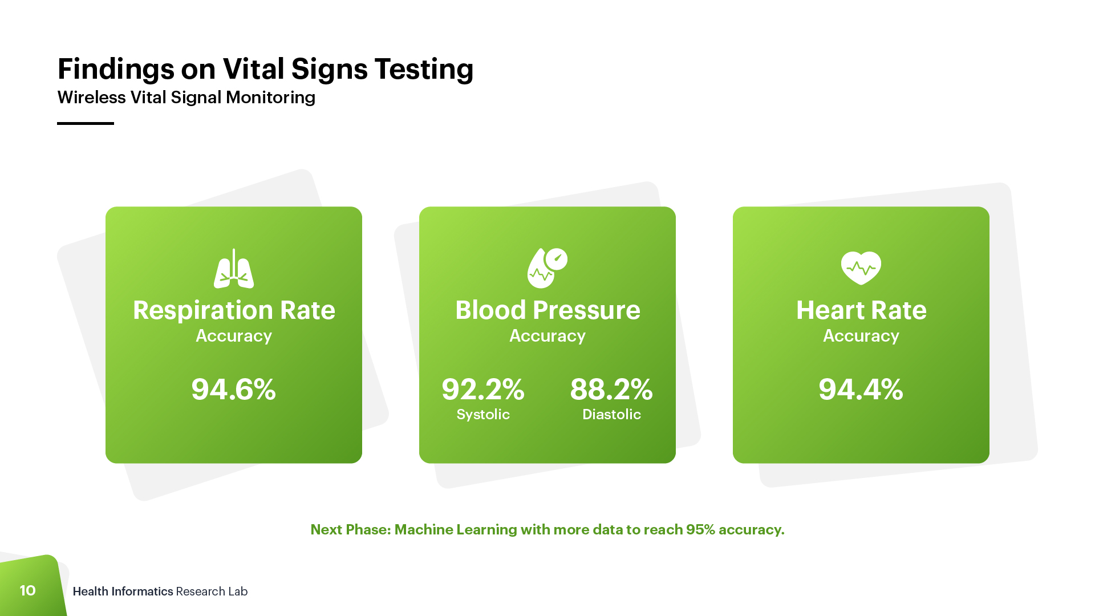
Notes:
we haven't reach 95% accuracy compared to gold standard, but we are working on our ML with more data to hit the target

Slide 11


